Slide 1

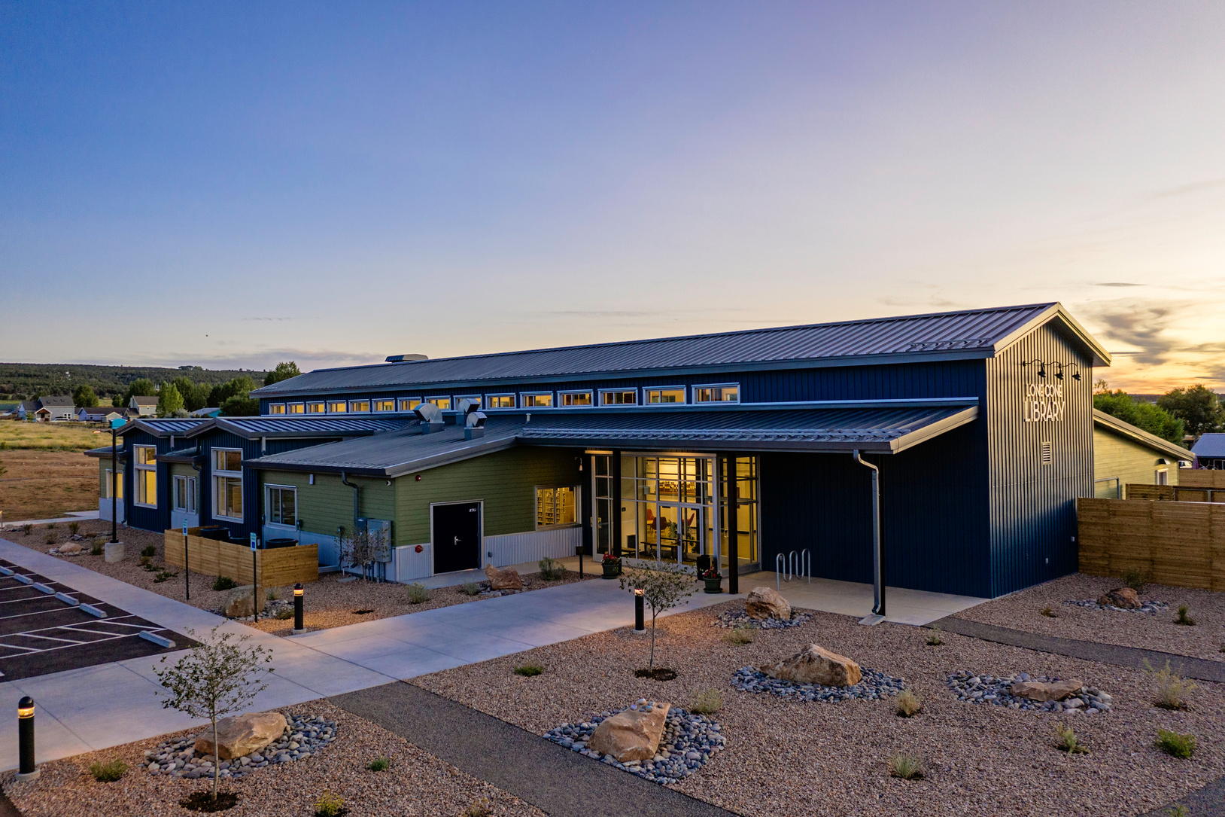
Lone Cone Library
2025 Year End report
Notes:
NOTE:
To change the image on this slide, select the picture and delete it. Then click the Pictures icon in the placeholder to insert your own image.

Slide 2

Table of Contents
Interim Director’s Message
2024/2025 Numbers Comparison
Most Borrowed Materials
Financial Overview
2025 Accomplishments
Goals and Initiatives
Programs
Grants
Community Partners
MISSION: “Nurturing community connections and empowering curiosity through service, resources, inclusive spaces, and meaningful discovery.”

Slide 3
Interim Director’s Message
Dear Board Members and Lone Cone Library Patrons,
As I reflect on 2025, I am filled with deep gratitude for a year that brought both significant change and meaningful growth. During a time of shifting leadership, I was given the unexpected opportunity to step into the role of Library Director. This experience has opened my eyes to the incredible responsibility, and privilege, of guiding a place that means so much to our community. I could not have navigated this transition without the steady encouragement and trust of our patrons, staff, and Board members. Your support has made all the difference.
Throughout the year, we have worked with great care and intention to steward our resources wisely. Every dollar, every hour of volunteer time, and every act of generosity has helped us continue to serve our community in ways that matter. We are profoundly grateful to our grantors, volunteers, and community members whose unwavering commitment allows the library to thrive.
As we look ahead to 2026, our hearts are full of hope and excitement. We are eager to embrace new opportunities, build meaningful partnerships, and continue growing alongside the community we love. With your continued support, we will keep striving to create a welcoming, enriching, and inspiring space for all who walk through our doors.
Thank you for being a vital part of the Lone Cone Library family.
Ever Thankful,
Kerry Bentler, Interim Library Director

Slide 4
2024/2025 Numbers Comparison
2024
2025
Highlights
Program attendance has JUMPED! More people are interacting together!
More materials are being checked out
Physical book checkouts was halved, BUT audiobooks increased over 600%
We are answering more questions and solving more problems than ever
The web page number is due to a different way of tracking.

Slide 5
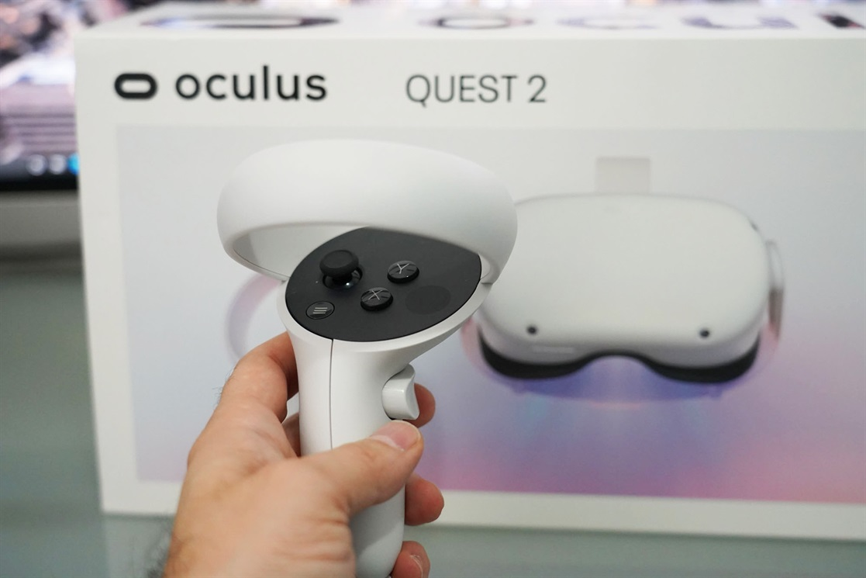
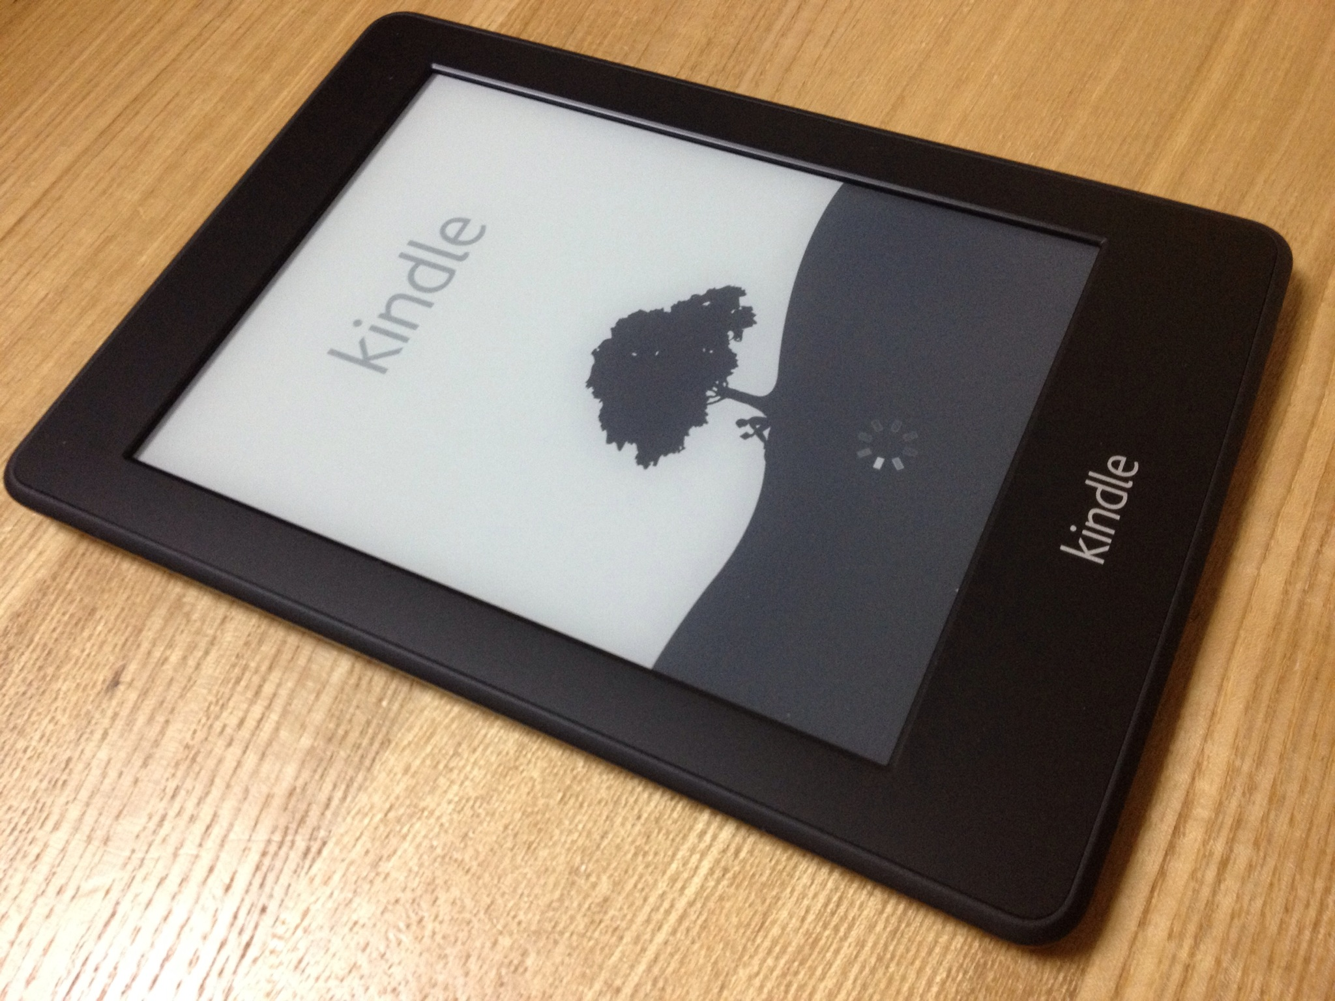
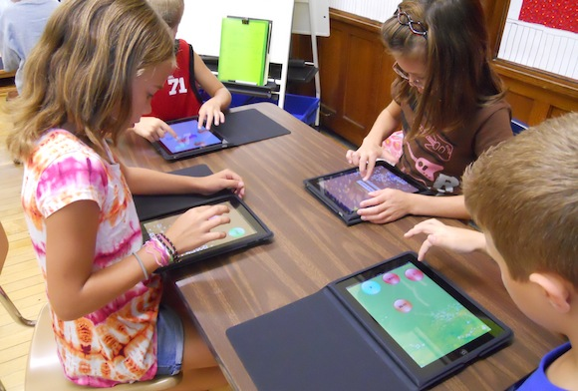
Most Borrowed Materials
Most Checkouts
Most Circulated Items
Ipads- 45 checkouts
Oculus Quest- 36 checkouts
Kid’s Kindle-14 checkouts
DVD: Legend of Boggy Creek-13 checkouts
Children’s Book: If You Give a Cat a Cupcake by Laura Numeroff-9 checkouts
Library of Things: 100 Animals Book leapfrog Kit-9 checkouts
Adult Book: Crow Trap by Ann Cleaves-8 checkouts
Non-Fiction Adult Book: Paleo perfected: 150 recipes-7 checkouts
Juvenile Fiction: Treasure Hunters by James Patterson-6 checkouts

Slide 6
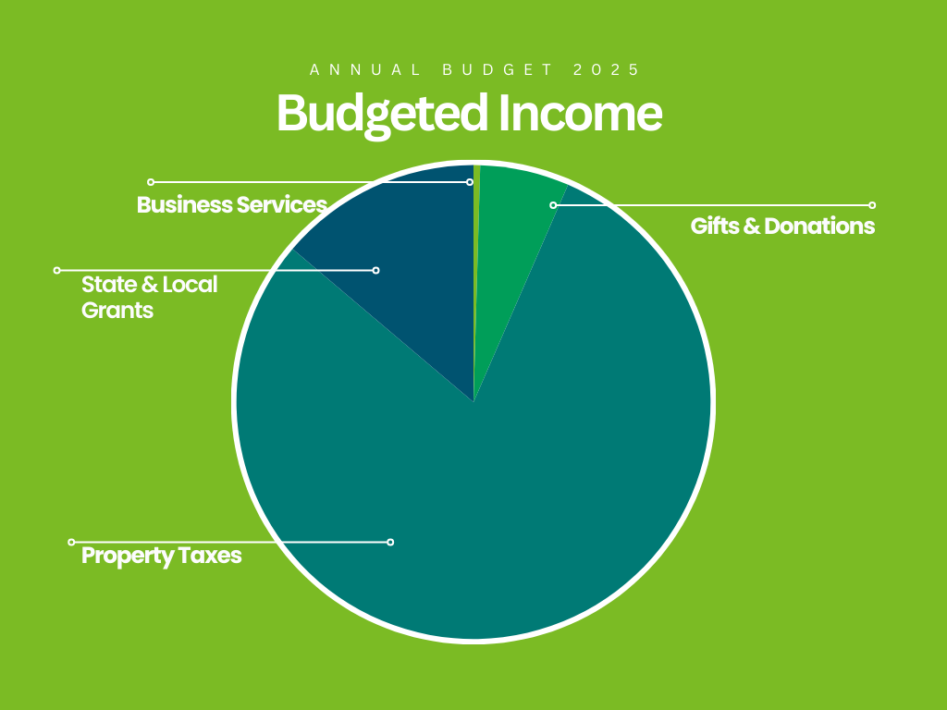
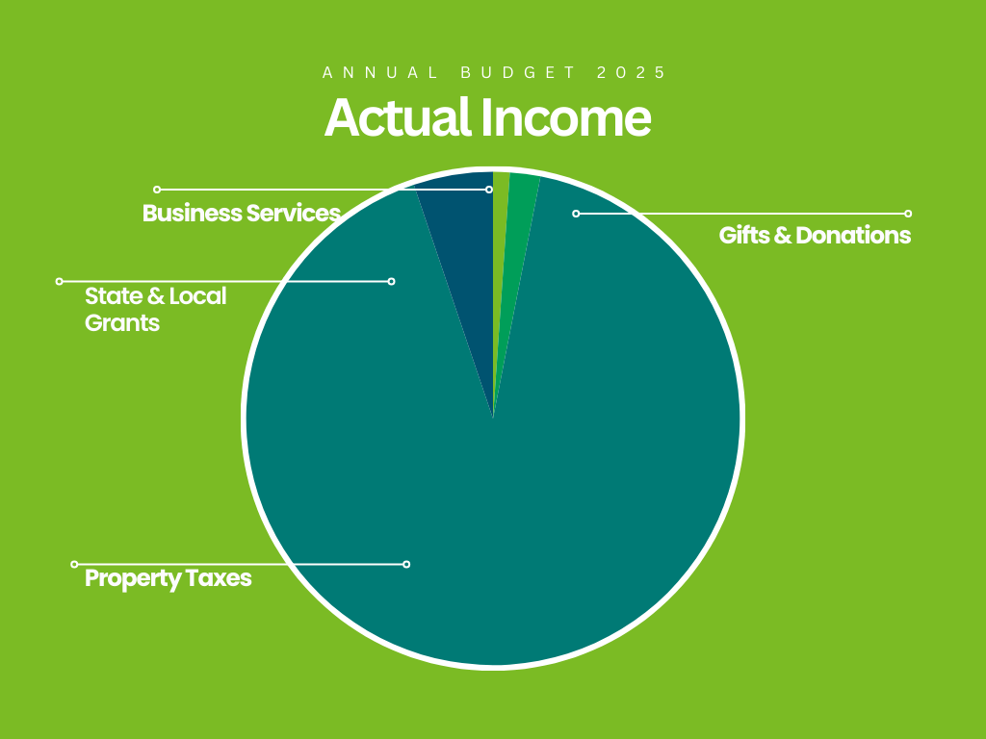
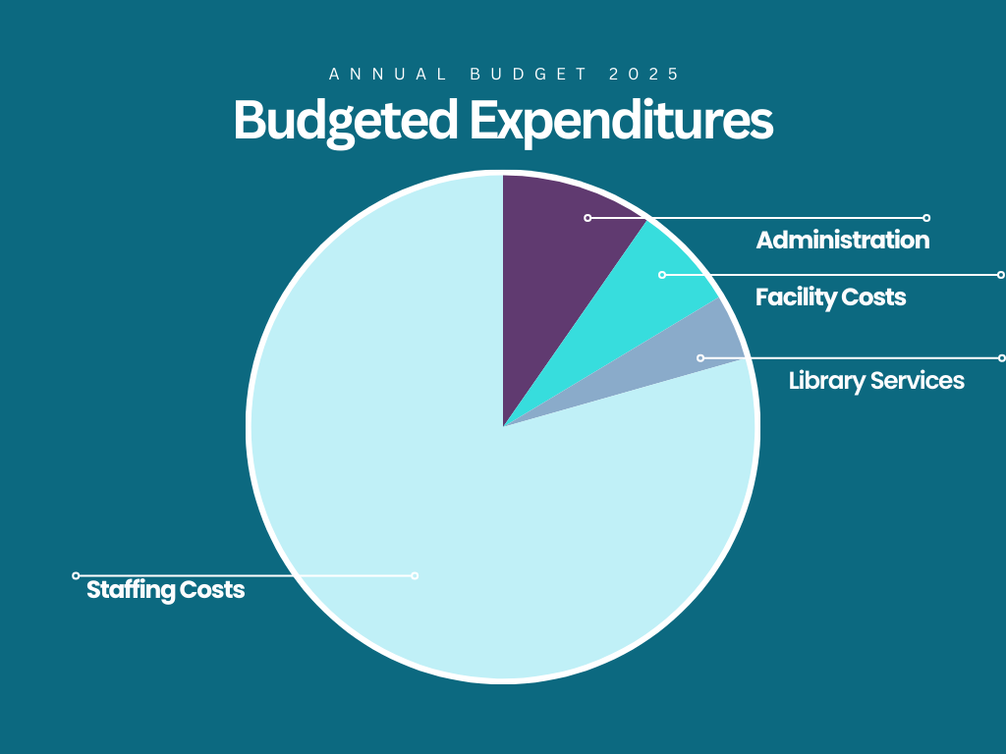
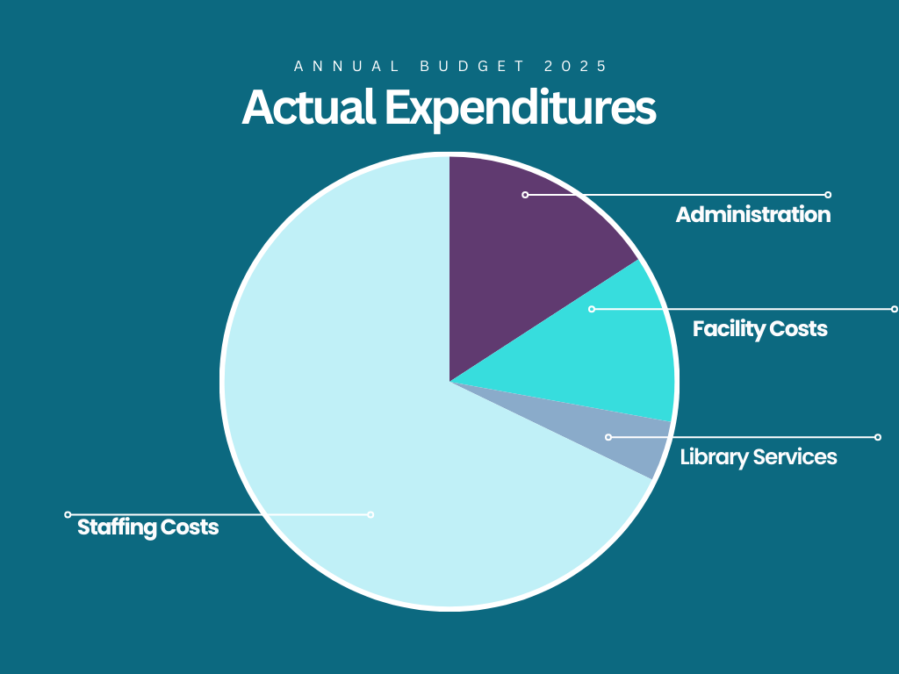
2025 Financial Overview (pie charts)
$671,998
$466,383.77
$667,005
$461,747.43

Slide 7
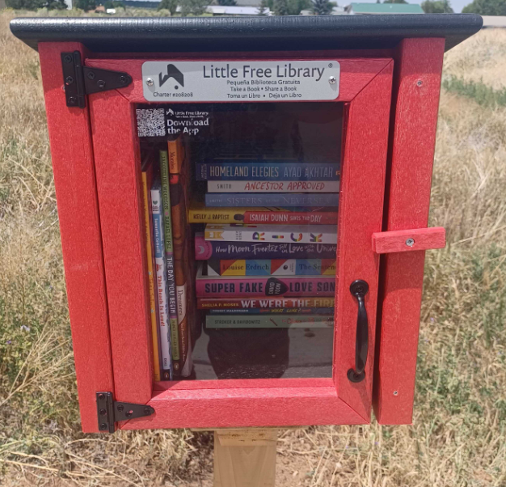
2025 Accomplishments
South Patio shade/tables-Thanks to grants from AARP and the Norwood Chamber of Commerce (community gathering/programming space)
Maintained staff through another transition/realigned job duties
Little Free Library up and prosperous
Re-vamped the entire computer lab for more efficiency and cuts costs
Designed and implemented the new logo
Grew our Library of Things with patron requests and suggestions from other libraries
Flag Disposal box and new partnership
Re-implemented Adult Craft night every month
Started the Blood Mobile coming into our community
Started senior yoga classes with a brand-new instructor (up to 3 classes per week!)
Started getting the Friends of the Library back up and running
Changed library hours to better serve patron needs and financials

Slide 8
Goals/Initiatives
Stronger Financial Foundation
Continue working toward $100,000 in reserves (3–5-year plan)
Partner with Friends of the Library
Maintain adequate staffing
Establish a plan for a Capital Campaign for 2027
Took 2026 off grant requests for Telluride Foundation
Focused grant writing (per bond language-community gathering/program spaces)
Completing an outdoor amphitheater on the south side of property
Completing walking trails on property
Adding a greenhouse to property (partner with CSU extension or similar groups)
Increase Senior and Teen program participation
New programs
Adjust current programs

Slide 9
Programs
Ongoing Programs
Chess Club
Dungeons & Dragons (Teens & kid groups)
Adult Book Club
Craft night
Gymnastics
Yoga
Senior yoga
Sound Bath
Free Friday Lunch
STEAM
Little’s Storytime
Library Club
Stories & Poems
Summer Reading Program
New programs/events in 2025
Trading Card Club
Ofrenda
Yard sale
Pancakes, PJs, and Polar Express
Coat Drive
“Let Them” event with Shelley Fourney
Hot lunch partnership w/Fresh Food Hub
Puzzle competition

Slide 10

2025 Grants
State Grants for Libraries: $5,000 (June 2024-July2025)
To help pay for some OverDrive expenses
Supplements circulation materials
Lone Cone Legacy Trust: $1,500 (Oct 2024-Sept 2025)
To help pay for Free Friday Lunches
San Miguel County: $5,000 (Jan-Dec 2025)
STEAM Assistant & Supplies
Computers
Telluride Foundation: $5,000 (Jan-Dec 2025)
To increase the Spanish literature
To offer partnerships for Spanish language events
Safety Grant (through SDA): $1,440 (Jan-Dec 2025)
To help pay for some training
Fire extinguishers/Fire blankets/ergonomic equipment
Norwood Chamber of Commerce: $1,000 (October 2025)
Two south side pergolas
AARP: $1,500 (October 2025)
Two outdoor picnic tables for south patio
Little Free Library (June 2025)
Outdoor book display/first set of books
Pilcrow: $600 match (February 2025)
Matching grants for certain books
Total: $21,040

Slide 11




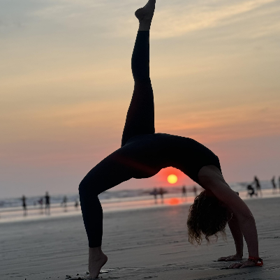













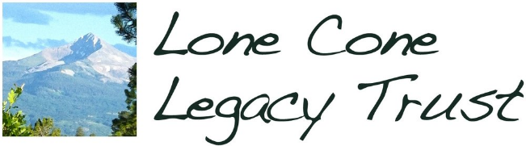


Community Partners
AARP
Colorado Department of Education
Colorado Workforce Consortium
Dark Sky Café
Fresh Food Hub
Lone Cone Legacy Trust
Norwood Chamber of Commerce of Wright’s Mesa
Norwood Dark Sky Advocates
Norwood Parks and Recreation
Norwood Public School
PinHead Institute
San Miguel County
San Miguel County 4-H
Talking Gourds (Telluride Institute)
Telluride Foundation
Telluride Theater
Tia Uphoff Gymnastics
Town of Norwood
Tri-County Health Network
Vitalant
Wright Stuff Community Foundation (PrimeTime)
Yoga Teacher: Marie Green

Slide 12

Thank you!
If you have any questions, please reach out to:
Kerry Bentler
Kerry@loneconelibrary.org
(970) 327-4833
www.loneconelibrary.org

